Slide 1

Predicting a Movie's Success
Briana Liu
Kanwal Iftikhar
Stephanie Gutierrez
Zach Blackburn

Slide 2

Overview:
Cinema is a captivating fusion of art and business, with predicting movie success before release being intricate.
This project delves into machine learning to examine if movie success can be forecasted using essential attributes.
The focus is on critical factors like budget, runtime, and genre to uncover patterns and insights.
The goal is to understand how these elements contribute to a movie's potential box office performance.

Slide 3

Question
Can we predict whether a movie will be successful depending on its:
Budget
Runtime
Genre

Slide 4
Dataset
The Kaggle dataset uses information from TMDB. This dataset contains two data sources: tmdb_5000_credits and tmdb_5000_movies.
tmdb_5000_credits features:
movie_id, title, cast, crew
tmdb_5000_movies features:
budget, genres, homepage, id, keywords, original_language, original_title, overview, popularity, production_companies, production_countries, release_date, revenue, runtime, spoken_languages, status, tagline, title, vote_average, vote_count

Slide 5
Methodology
Data Acquisition
Obtain the TMDB 5000 Movie Dataset from Kaggle.
Data Preprocessing & Cleaning
Handle missing values, duplicates, and irrelevant features
Exploratory Data Analysis
Perform exploratory analysis to understand the distribution of features and their relationships.
Create visualizations to present findings and insights.
Visualization & Reporting
Train each selected model on the training data.
Model Training & Evaluation
Model Selection & Preparation
Feature Selection
Visualize key insights through graphs and plots.
Generate a correlation matrix to identify significant feature correlations.
Select relevant features to include in the predictive model.
Identify features that have a strong correlation with movie success metrics.
Choose suitable supervised learning models for prediction (Decision Tree, Random Forest, K-nearest Neighbors, SVM).

Slide 6
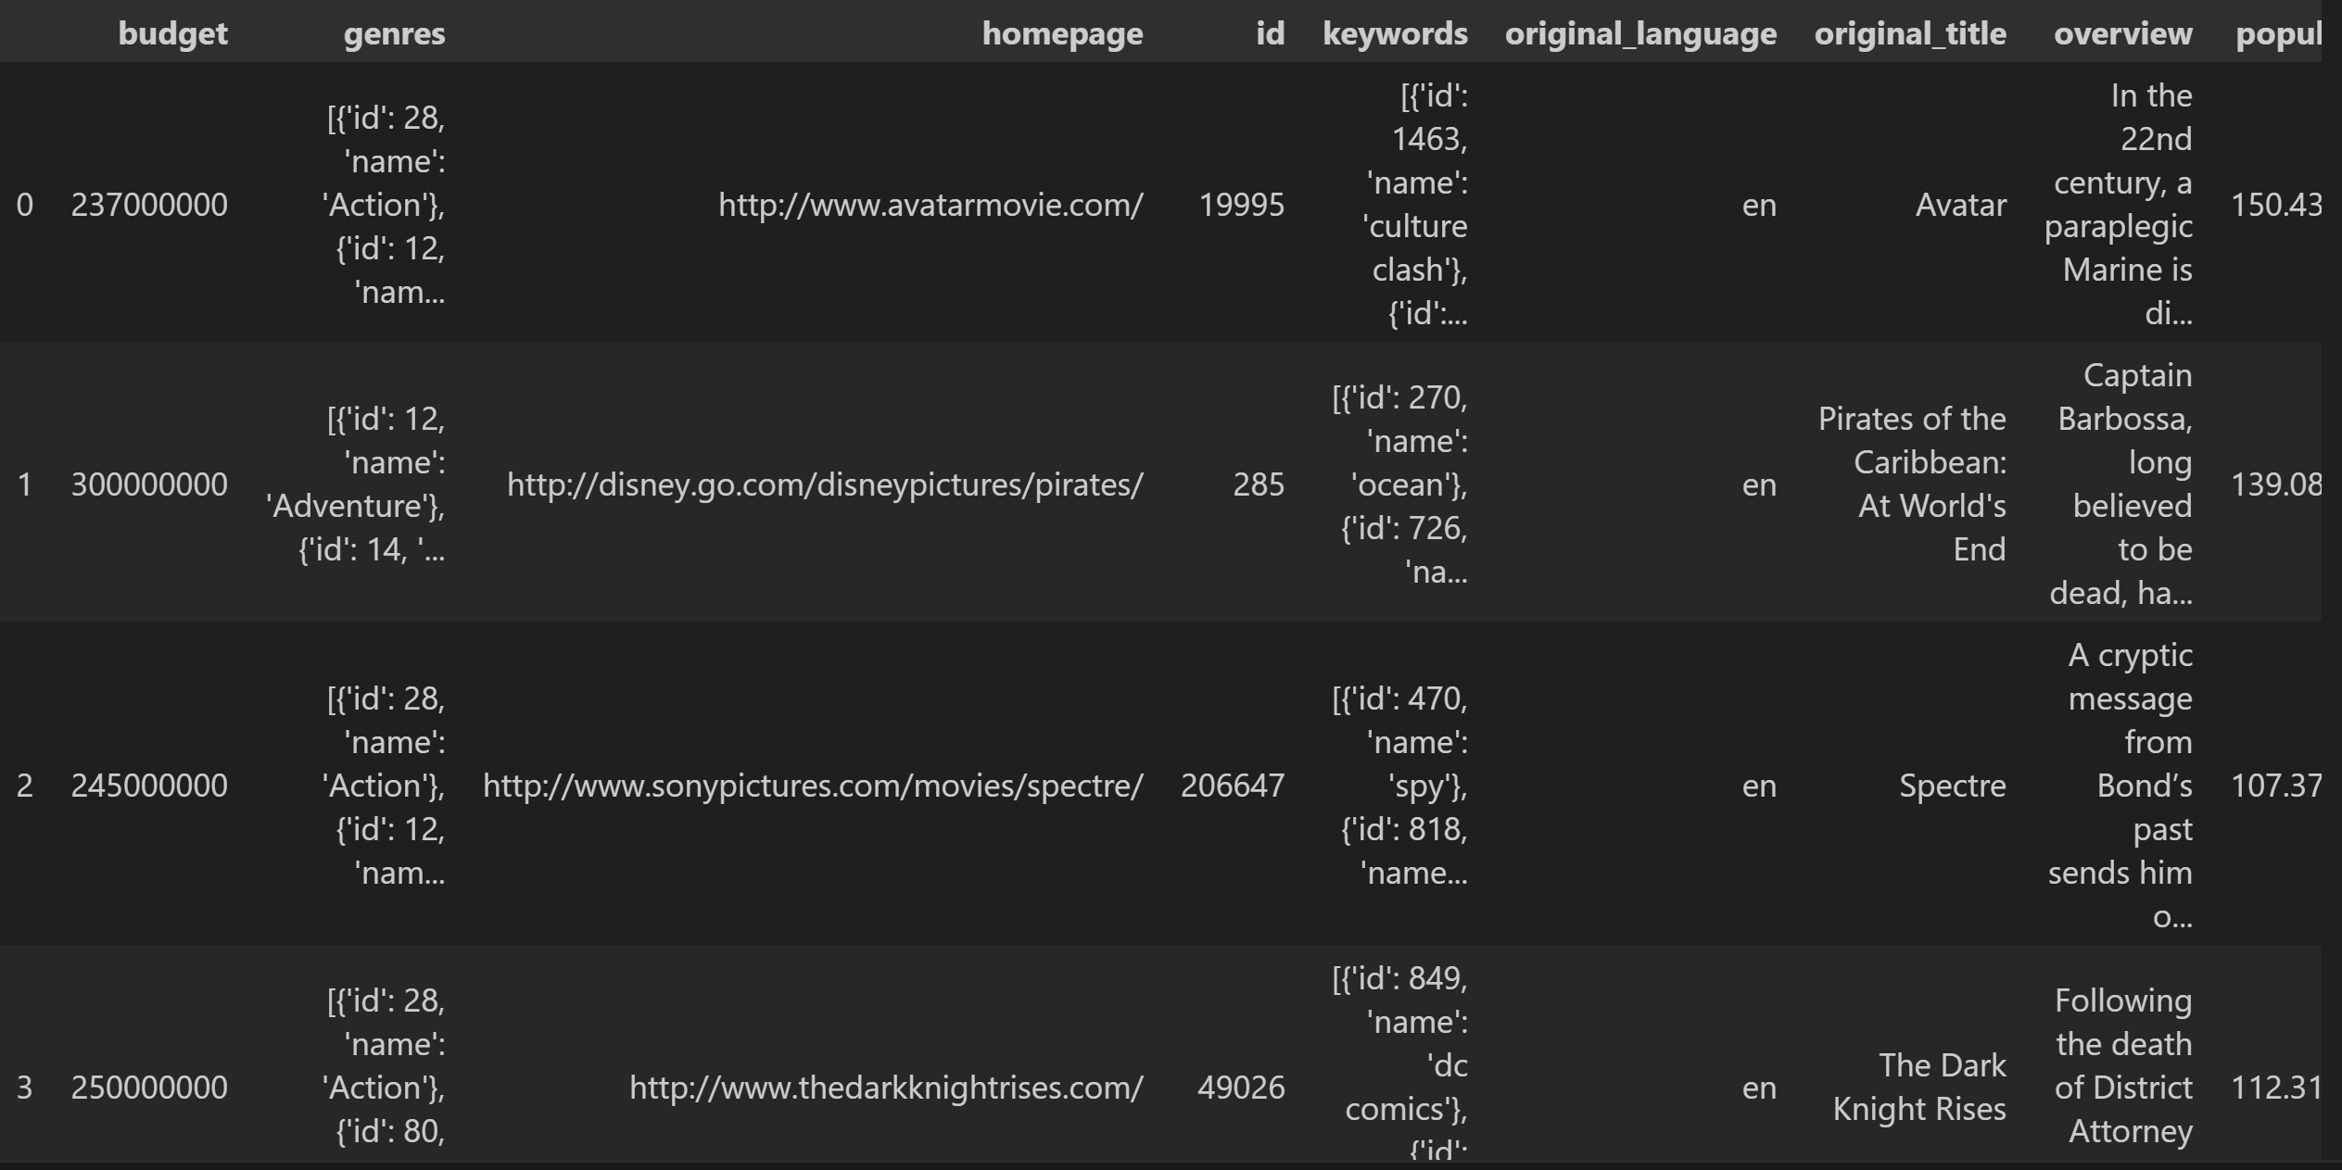
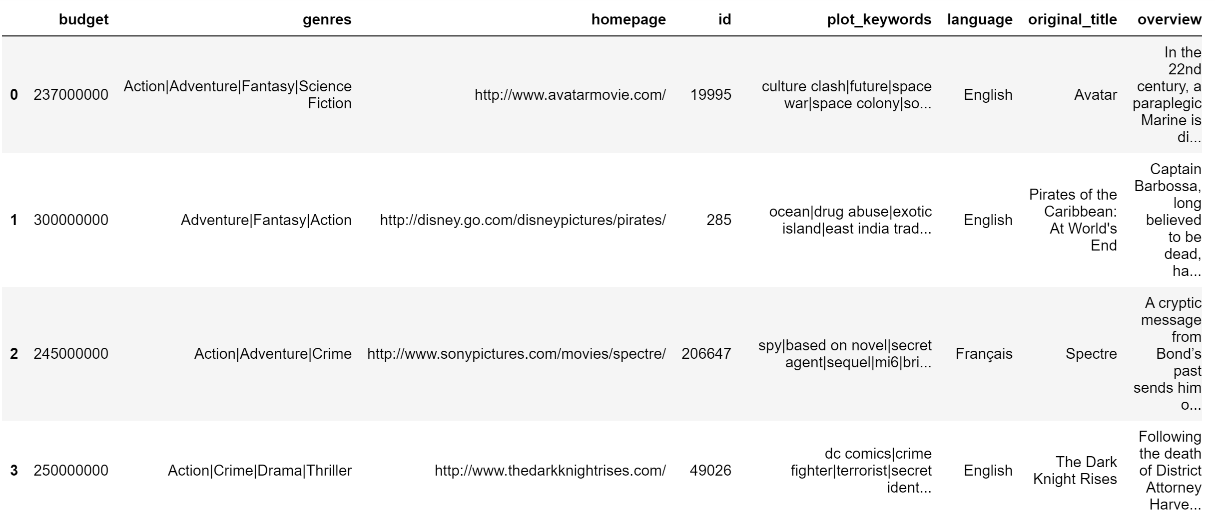
Data Preprocessing Before and After

Slide 7
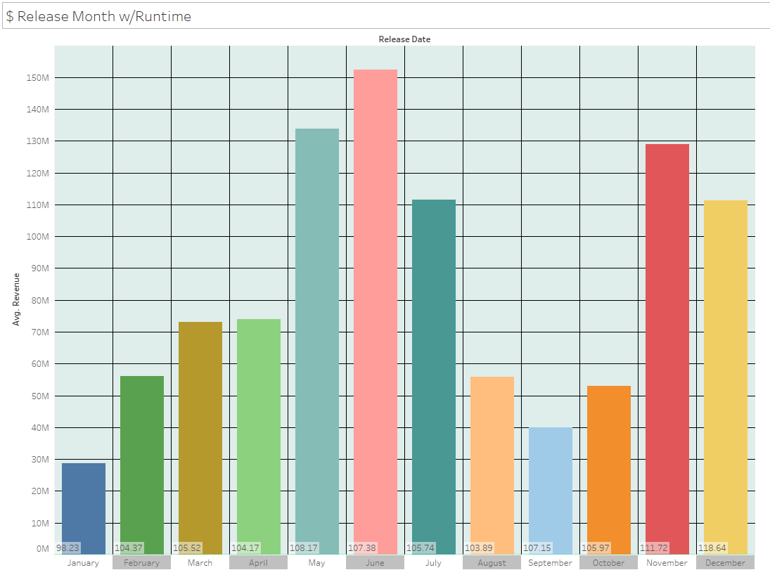
Release Month w/Runtime

Slide 8
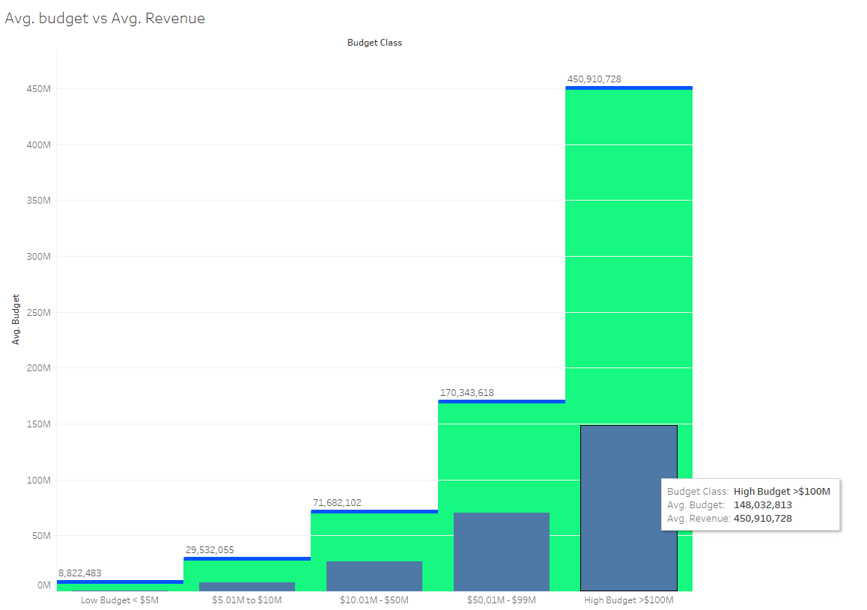
Average Budget vs. Average Revenue

Slide 9
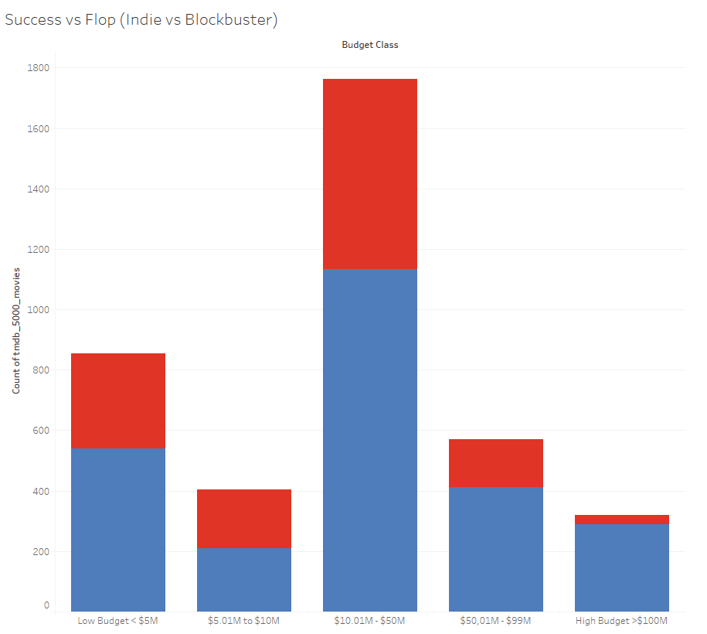
Success vs. Flop

Slide 10

Success Criteria
'Popularity Success’: Movie successful if a movie's popularity feature is greater than the mean of all popularity scores.
'Vote Success': likewise, if the voting_average of a movie is higher than the mean of all vote averages it is successful.
'Commercial Success': if a movie's gross profit exceeds its budget then it is successful.

Slide 11

Supervised Learning Models
Decision Tree
Random Forest
K-nearest Neighbors
Support Vector Machine (SVM)

Slide 12
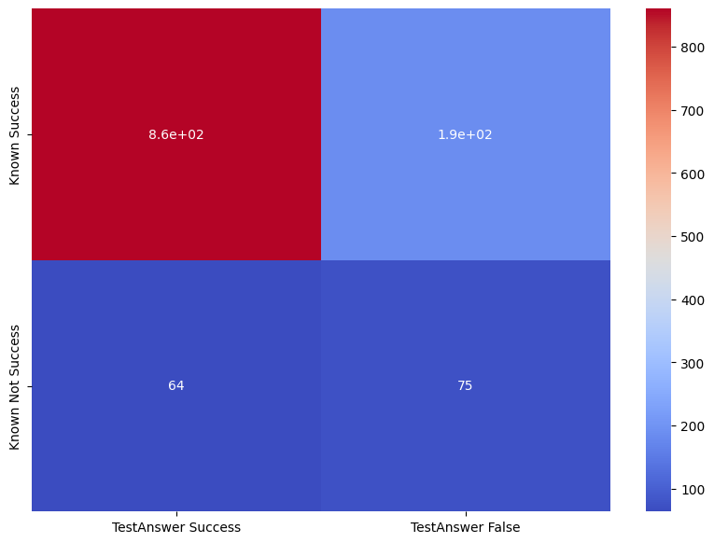
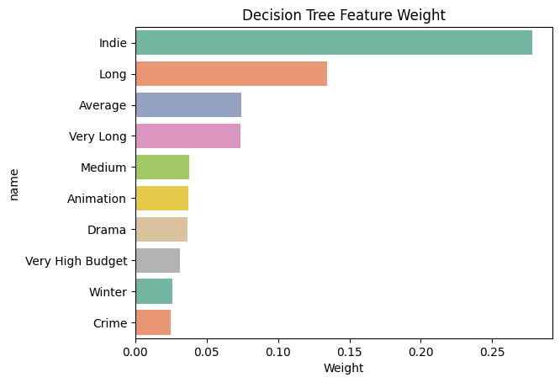
Decision Tree
To train our models, we split our data randomly so that 75% is used as training and 25% as predictions.
Cross-validation accuracy: 77%
Overall accuracy: 79%

Slide 13
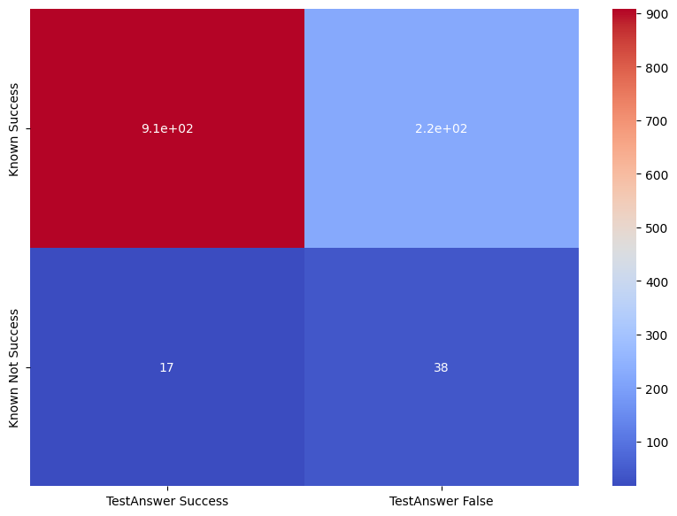
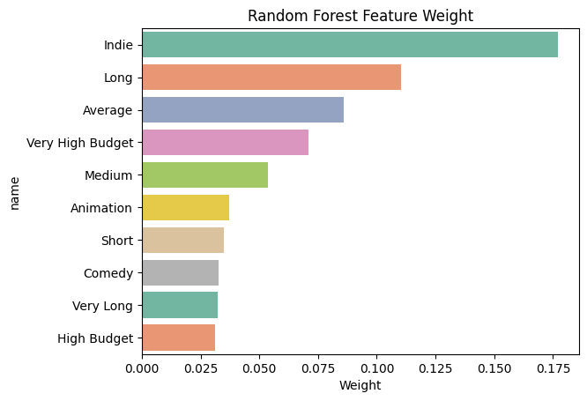
Random Forest Results
Cross-validation accuracy: 76%
Overall accuracy: 79%

Slide 14
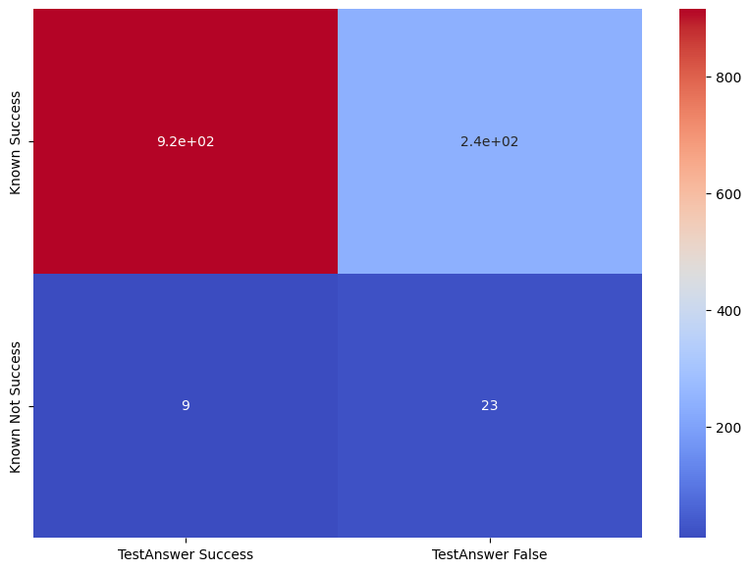
K-Nearest Neighbors
Cross-validation accuracy: 79%
Overall accuracy: 79%

Slide 15

Support Vector Machine Model
Cross-validation accuracy: 76%
Overall accuracy: 79%

